Slide 1

18.404/6.840 Lecture 20
Last time: - Games and Quantifiers
- Generalized Geography is PSPACE-complete
- Logspace: L and NL
Today: (Sipser §8.4) - Review NL $⊆$ P
- Review NL $⊆$ SPACE$\left(\log^{2}{n}\right)$
- NL-completeness
- NL = coNL
1

Slide 2



Review: log space
Model: 2-tape TM with read-only input tape for defining sublinear space computation.
Defn: L = SPACE$\left(\log{n}\right)$
NL = NSPACE$\left(\log{n}\right)$
Log space can represent a constant number of pointers into the input.
Examples
$\left\{ww^{ℛ} \right| w∈Σ^{∗}\}∈$ L
$PATH∈$ NL
doesn’t count towards space used
input tape
read-only
count cells used here
work tape
read/write
$$O\left(\log{n}\right)$$
ababbaaaaaaaaaabbaba
input tape
$$G=\left(\left(v_{3},v_{5}\right), \left(v_{7}, v_{22}\right), …\right), s=⋯, t=⋯$$
Work tape tracks the current node on the guessed path.
Nondeterministically select the nodes of a path connecting $s$ to $t$.
Work tape tracks corresponding locations in the input tape.
NL
L
L = NL? Unsolved
2

Slide 3
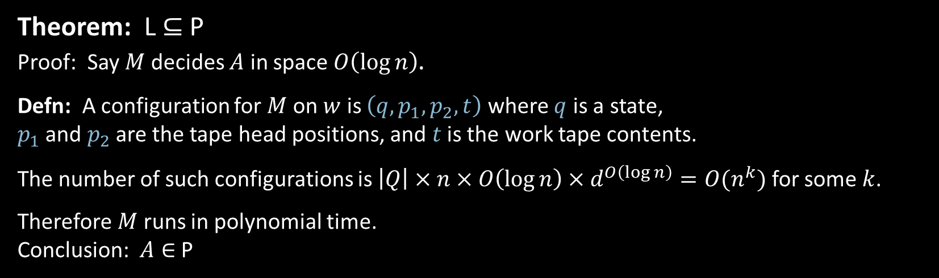





Review: L $⊆$ P
Theorem: L $⊆$ P
Proof: Say $M$ decides $A$ in space $O\left(\log{n}\right)$.
Defn: A configuration for $M$ on $w$ is $\left(q,p_{1},p_{2},t\right)$ where $q$ is a state, $p_{1}$ and $p_{2}$ are the tape head positions, and $t$ is the work tape contents.
The number of such configurations is $\left|Q\right|×n×O\left(\log{n}\right)×d^{O\left(\log{n}\right)}={O(n}^{k})$ for some $k$.
Therefore $M$ runs in polynomial time.
Conclusion: $A∈$ P
$$p_{1}$$
$$q$$
read-only input
$$p_{2}$$
$$t$$
3

Slide 4







Review: NL $⊆$ $\text{SPACE}\left(\log^{2}{n}\right)$
Theorem: NL $⊆$ $\text{SPACE}\left(\log^{2}{n}\right)$
Proof: Savitch’s theorem works for log space
$$O(\log{n) }$$
Each recursion level stores 1 config = $O\left(\log{n}\right)$ space.
Number of levels = $\log{t}=O\left(\log{n}\right)$.
Total $O\left(\log^{2}{n}\right)$ space.
$q_{0}w_{1}⋯w_{n}$
$$⋯ q\text{accept} ⋯$$
˽ … ˽
recurse
aaba$q_{7}$da$⋯$cab
$$t=d^{O\left(log n\right)}$$
recurse
4

Slide 5








Review: NL $⊆$ P
Theorem: NL $⊆$ P
Proof: Say NTM $M$ decides $A$ in space $O\left(\log{n}\right)$.
Defn: The configuration graph $G_{M,w}$ for $M$ on $w$ has
nodes: all configurations for $M$ on $w$
edges: edge from $c_{i}→c_{j}$ if $c_{i}$ can yield $c_{j}$ in 1 step.
Claim: $M$ accepts $w$ iff the configuration graph $G_{M,w}$ has a path from $c_{start}$ to $c_{accept}$
Polynomial time algorithm $T$ for $A$:
$T=$ “On input $w$
1. Construct $G_{M,w}$. [polynomial size]
2. Accept if there is a path from $c_{start}$ to $c_{accept}$. Reject if not.”
configuration graph $G_{M,w}$
$$c_{start}$$
$$c_{accept}$$
iff $M$ accepts $w$
$$c_{i}$$
$$c_{j}$$
P
NL
L = P? Unsolved
L
5

Slide 6

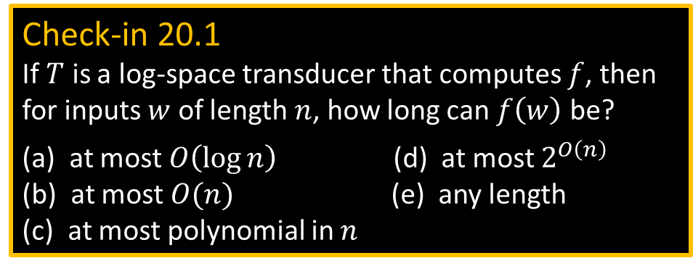



NL-completeness
Check-in 20.1
If $T$ is a log-space transducer that computes $f$, then for inputs $w$ of length $n$, how long can $f\left(w\right)$ be?
(a) at most $O\left(\log{n}\right)$ (d) at most $2^{O\left(n\right)}$
(b) at most $O(n)$ (e) any length
(c) at most polynomial in $n$
Defn: $B$ is NL-complete if
$B∈$NL
For all $A∈$NL, $A≤_{L}B$
Log-space reducibility
Defn: A log-space transducer is a TM with three tapes:
read-only input tape of size $n$
read/write work tape of size $O(\log{n})$
write-only output tape
A log-space transducer $T$ computes a function $f:Σ^{∗}→Σ^{∗}$ if $T$ on input $w$ halts with $f\left(w\right)$ on its output tape for all $w$.
Say that $f$ is computable in log-space.
Defn: $A$ is log-space reducible to $B$ ($A≤_{L}B$) if $A≤_{m}B$ by a reduction function that is computable in log-space.
read-only input
$$T$$
read/write work
$$O\left(\log{n}\right)$$
write-only output
Theorem: If $A≤_{L}B$ and $B∈$L then $A∈$ L
Proof: TM for $A=$ “On input $w$
1. Compute $f(w)$
2. Run decider for $B$ on $f\left(w\right)$. Output same.”
BUT we don’t have space to store $f(w)$.
So, (re-)compute symbols of $f(w)$ as needed.
6
Check-in 20.1

Slide 7










$PATH$ is NL-complete
Theorem: $PATH$ is NL-complete
Proof: 1) $PATH∈$NL ✓
2) For all $A∈$NL, $A≤_{L}PATH$
Let $A∈$ NL be decided by NTM $M$ in space $O\left(\log{n}\right)$.
[Modify $M$ to erase work tape and move heads to left end upon accepting.]
Give a log-space reduction $f$ mapping $A$ to $PATH$.
$f\left(w\right)=〈G,s,t〉=〈G_{M,w},c_{start},c_{accept}〉$
$w∈A$ iff $G$ has a path from $s$ to $t$
Here is a log-space transducer $T$ to compute $f$ in log-space.
$$G_{M,w}$$
$$c_{start}$$
$$c_{accept}$$
$$f\left(w\right)=$$
$$c_{i}$$
$$c_{j}$$
read-only input
$T=$“on input $w$
For all pairs $c_{i}, c_{j}$ of configurations of $M$ on $w$.
Output those pairs which are legal moves for $M$.
Output $c_{start}$ and $c_{accept}$.”
$$w$$
$$T$$
$$c_{i}$$
$$c_{j}$$
read/write work
$$O\left(\log{n}\right)$$
write-only output
$${(G}_{M,w}=\left(c_{3}, c_{7}\right), \left(c_{6}, c_{22}\right), … ) (c_{start}=⋯) (c_{accept}=⋯)$$
7

Slide 8


$\overline{2SAT}$ is NL-complete
Theorem: $\overline{2SAT}$ is NL-complete
Proof: 1) Show $\overline{2SAT}∈$ NL good exercise
2) Show $PATH≤_{L}\overline{2SAT}$
Give log-space reduction f from $PATH$to $\overline{2SAT}$.
$f\left(〈G,s,t〉\right)=〈φ〉$
For each node $u$ in $G$ put a variable $x_{u}$ in $φ$.
For each edge $(u,v)$ in $G$, put a clause $(x_{u}→x_{v})$ in $φ$ [equivalent to $\left(\overline{x_{u}}∨x_{v}\right)$].
In addition put the clauses $(x_{s}∨x_{s})$ and $(x_{t}→\overline{x_{s}})$ in $φ$.
Show $G$ has an path from $s$ to $t$ iff $φ$ is unsatisfiable.
($→$) Follow implications to get a contradiction.
($←$) If $G$ has no path from $s$ to $t$, then assign all $x_{u}$ True where $u$ is reachable from $s$, and all other variables False. That gives a satisfying assignment to $φ$.
Straightforward to show $f$ is computable in log-space.
8

Slide 9








NL = coNL (part 1/4)
Theorem (Immerman-Szelepcsényi): NL = coNL
Proof: Show $\overline{PATH}∈$ NL
Defn: NTM $M$ computes function $f:Σ^{∗}→Σ^{∗}$ if for all $w$
All branches of $M$ on $w$ halt with $f\left(w\right)$ on the tape or reject.
Some branch of $M$ on $w$ does not reject.
Let $path\left(G,s,t\right)=\left\{\begin{aligned} \\ \end{aligned}\right.$
Let $R=R\left(G,s\right)=\left\{u\right| path\left(G,s,u\right)=$ YES}
Let $c=c\left(G,s\right)=|R|$
$R$ = Reachable nodes
$c$ = # reachable
Check-in 20.2
Consider the statements: (1) $\overline{PATH}∈$ NL, and (2) Some NL-machine computes the $path$ function.
What implications can we prove easily?
(1) $→$ (2) only
(2) $→$ (1) only
Both implications
Neither implication
Theorem: If some NL-machine (log-space NTM) computes $path$, then some NL-machine computes $c$.
Proof: “On input $〈G,s〉$
1. Let $k←0$
2. For each node $u$
3. If $path\left(G,s,u\right)=$ YES, then $k←k+1$
4. If $path\left(G,s,u\right)=$ NO, then continue
5. Output $k$”
Next: Converse of above
YES, if $G$has a path from $s$ to $t$
NO, if not
$$G$$
$$R$$
$$s$$
$$c=|R|$$
9
Check-in 20.2

Slide 10





NL = coNL (part 2/4) – key idea
Theorem: If some NL-machine computes $c$, then some NL-machine computes $path$.
Proof: “On input $〈G,s,t〉$
1. Compute $c$
2. $k←0$
3. For each node $u$
4. Nondeterministically go to (p) or (n)
(p) Nondeterministically pick a path from $s$ to $u$ of length $≤m$.
If fail, then reject.
If $u=t$, then output YES, else set $k←k+1$.
(n) Skip $u$ and continue.
5. If $k≠c$ then reject.
6. Output NO.” [found all $c$ reachable nodes and none were $t$}
$$G$$
$$R$$
$$s$$
$$c=|R|$$
10

Slide 11







NL = coNL (part 3/4)
Let $path_{d}\left(G,s,t\right)=\left\{\begin{aligned} \\ \end{aligned}\right.$
Let $R_{d}=R_{d}\left(G,s\right)=\left\{u\right| path_{d}\left(G,s,u\right)=$ YES}
Let $c_{d}=c_{d}\left(G,s\right)=|R_{d}|$
YES, if $G$has a path $s$ to $t$ of length $≤d$
NO, if not
Theorem: If some NL-machine computes $c_{d}$, then some NL-machine computes $path_{d}$.
Proof: “On input $〈G,s,t〉$
1. Compute $c_{d}$
2. $k←0$
3. For each node $u$
4. Nondeterministically go to (p) or (n)
(p) Nondeterministically pick a path from $s$ to $u$ of length $≤d$.
If fail, then reject.
If $u=t$, then output YES, else set $k←k+1$.
(n) Skip $u$ and continue.
5. If $k≠c_{d}$ then reject.
6. Output NO” [found all $c_{d}$ reachable nodes and none were $t$}
$$G$$
$$R_{d}$$
$$s$$
$$c_{d}=|R_{d}|$$
11

Slide 12




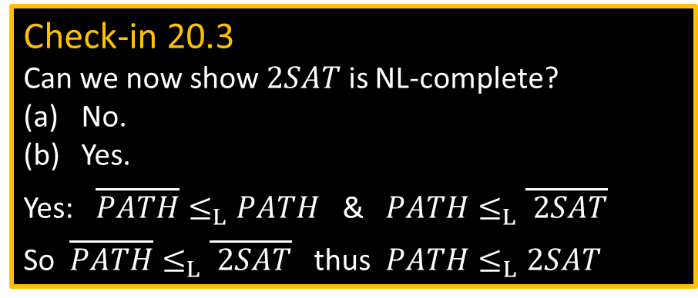

NL = coNL (part 4/4)
Theorem: If some NL-machine computes $c_{d}$, then some NL-machine computes $path_{d+1}$.
Proof: “On input $〈G,s,t〉$
1. Compute $c$
2. $k←0$
3. For each node $u$
4. Nondeterministically go to (p) or (n)
(p) Nondeterministically pick a path from $s$ to $u$ of length $≤d$.
If fail, then reject.
If $u$ has an edge to $t$, then output YES, else set $k←k+1$.
(n) Skip $u$ and continue.
5. If $k≠c_{d}$ then reject.
6. Output NO.” [found all $c_{d}$ reachable nodes
and none had an edge to $t$}
$$G$$
$$R_{d}$$
$$R_{d+1}$$
$$s$$
$$c_{d}=|R_{d}|$$
Check-in 20.3
Can we now show $2SAT$ is NL-complete?
No.
Yes.
Yes: $\overline{PATH}≤_{L}PATH$ & $PATH≤_{L}\overline{ 2SAT}$
So $\overline{PATH}≤_{L}\overline{ 2SAT}$ thus $PATH≤_{L}2SAT$
Hence $\overline{PATH}∈$ NL
“On input $〈G,s,t〉$
1. $c_{0}=1$.
2. Compute each $c_{d+1}$ from $c_{d}$ for $d=1$ to $m$.
3. Accept if $path_{m}(G,s,t)$ = NO.
4. Reject if $path_{m}(G,s,t)$ = YES.”
Corollary: Some NL-machine computes $c_{d+1}$ from $c_{d}$.
12
Check-in 20.3

Slide 13

Quick review of today
Log-space reducibility
L = NL? question
$PATH$ is NL-complete
$\overline{2SAT}$ is NL-complete
NL = coNL
13

Slide 14
MIT OpenCourseWare
https://ocw.mit.edu
18.404J Theory of Computation
Fall 2020
For information about citing these materials or our Terms of Use, visit: https://ocw.mit.edu/terms.

